Slide 1
Capturing, writing and reading maths electronically - what works
Dr Abi James
Accessibility Group
WAIS

Slide 2
Why avoid using pen and paper?
Problems with hand writing notes:
physical difficulty with creating notes;
unable to concentrate or accurately take down notes in a seminar or lecture
Want to manipulate notes afterwards;
Search
Correct & convert to print
Need accessible maths notes
Want to write maths in an accessible format

Slide 3
Accessible Maths Content
MathML enables accessible maths content to be created, displayed & spoken
MathPlayer, MathJax and browser plug-ins support accessible maths on the web
MathML based tools can also be utilized off-line
Firefox support MathML. Internet Explorer requires the MathPlayer plug-in.

Slide 4
4 other ways of capturing mathematical & science information
Video
Audio
Typing
Speech

Slide 5
Technology for Capturing notes with maths and science content
Audio Capture
Digital Pens
Tablets
Hand-writing recognition
text
maths
Photos & Video

Slide 6
Audio Capture
Digital recording
Difficult to capture 2-D nature of equations
Difficult to capture working through an equation
But can be enhanced….
Demonstration of Audio Notetaker 3.0

Slide 7
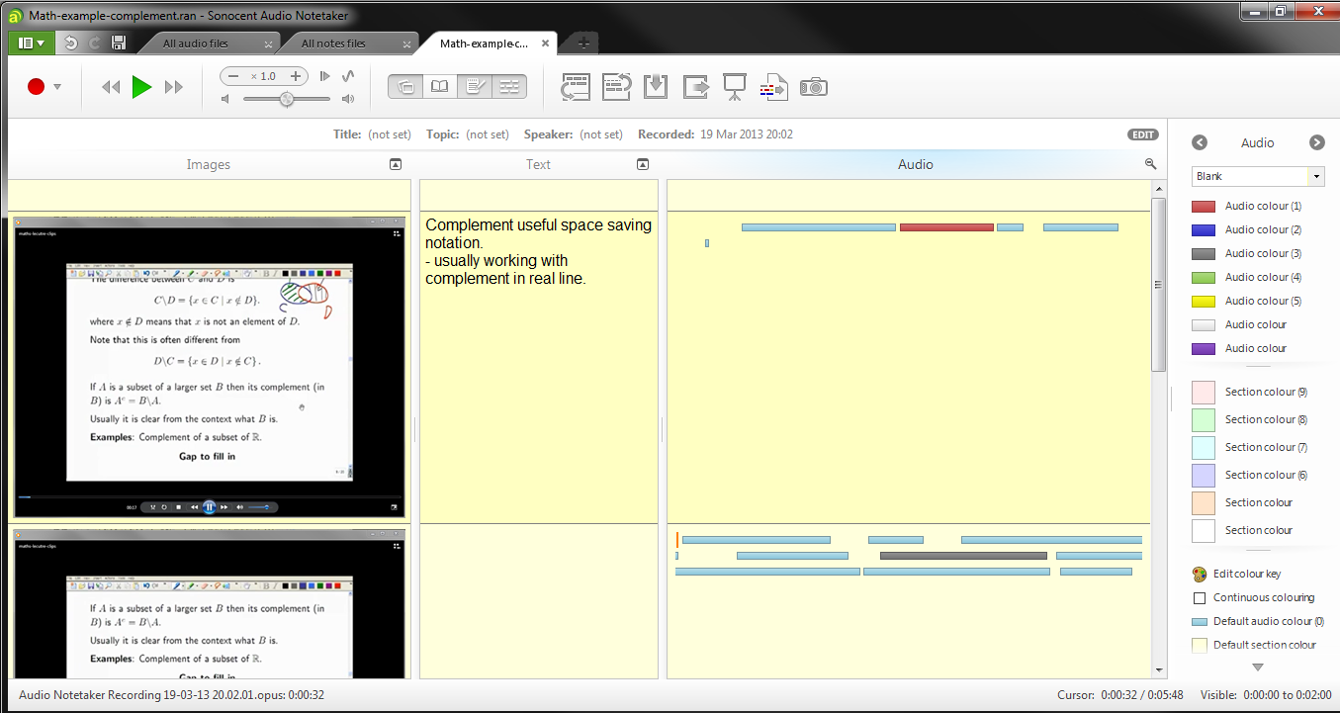
Audio NoteTaker v3.0
Notes:
Audio Notetaker v3 features:
- Visual representation of audio – navigate and edit like text.
Record live during lectures
Annotate audio with colour and text notes
Import images, PDFs alongside audio
Screen capture from videos and webinars
- possible to import LiveScribe audio and annotated notes – see http://support.sonocent.com/customer/portal/articles/779669-can-i-use-audio-notetaker-with-live-scribe-pens-

Slide 8
Digital Pens: Enhanced Pen & Paper
Using special paper digital pens capture text that is written as well as recording audio
Content can then be transferred to a computer in a digital format.
Audio is linked to text.
Notes are searchable & can go through hand-writing recognition.
Demonstration of a LiveScribe Echo Pen

Slide 9
LiveScribe Pen
Notes:
http://www.livescribe.com/en-us/solutions/learningdisabilities/
Good example of how an engineering student uses LiveScribe at http://www.podcast-directory.co.uk/episodes/episode-11-livescribe-9279749.html
But hand-writing recognition has issues. Can not recognise:
- miss-spelt words
Specialist vocabulary
Best used for searching hand-written text.

Slide 10
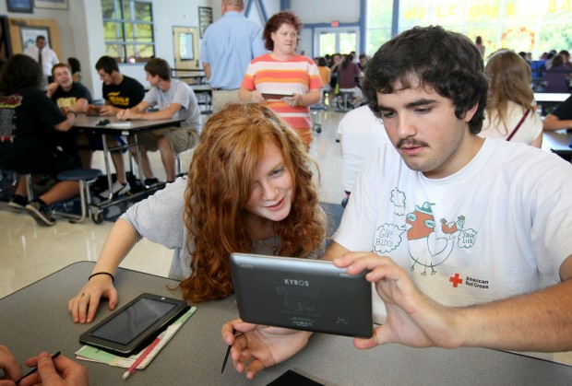
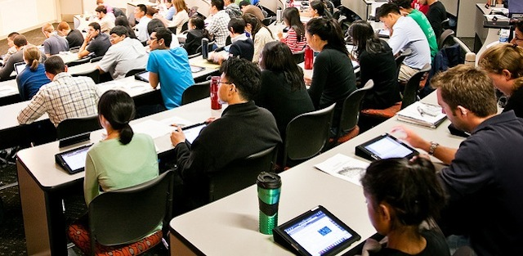
Tablets for note-taking maths?
3 different “tablet” operating systems now available:
iOS = iPad
Android = Google Nexus
Windows RT

Slide 11
Tablets for note-taking maths?
Why are we interested in Tablets?
Small and light
Designed for note-taking
But Windows tablets have been around for many years
Windows 8 multi-touch tablets now available.

Slide 12
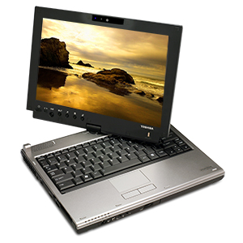
Tablets ... the story 5 years ago
During Nov – Dec 2007, provided 4 students with Toshiba Windows Vista tablets for 4 weeks at Loughborough
To support maths and engineering students who have difficulties:
laying out notes
taking accurate notes
editing and proofing math based assignments.
Also tried maths hand-writing recognition

Slide 13
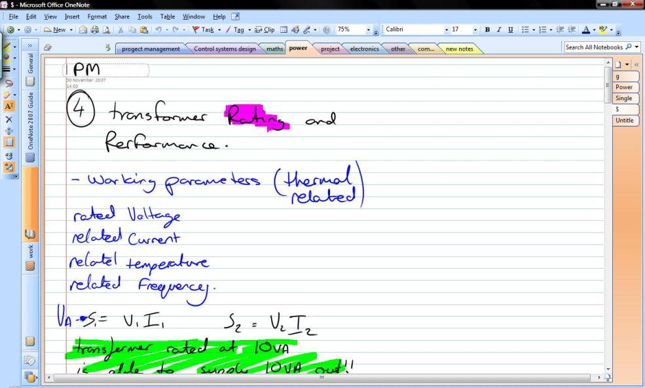
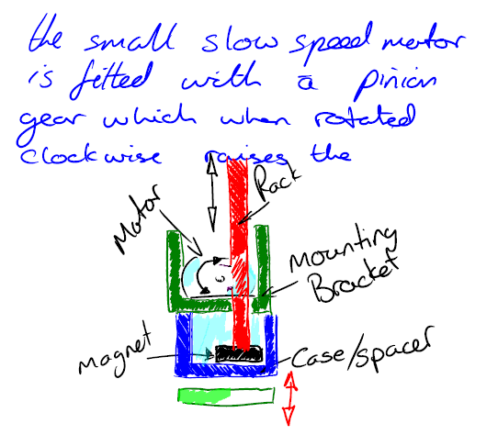
Tablet PC’s & OneNote for Engineering Students (2007)
“Notes are less confusing as errors are erased easily”
“So much easier - everything is in the same place, all organised, not a piece of paper floating in the bottom of the bag.”

Slide 14
Hand writing recognition & maths
Handwritten text recognition relies on good spelling & recognising words from a dictionary
Hand-written maths relies on real-time analysis of strokes as symbols are formed
Much more dependent on accuracy & spatial layout
Formation of symbols is not consistent
Across countries
Across individuals
But built into Windows (and MathType)
Starting to appear on tablet apps e.g. MathBrush

Slide 15
Working with PDF files
Lecture notes, articles & learning materials often shared as PDF files.
Digital pens don’t work
Tablets do! Can:
Annotate PDF files e.g. Good Reader, Documents
Can be read aloud if accessible
But maths, diagrams, images are not accessible.
Good, accessible PDF files are hand to find

Slide 16
Apps for maths note-taking
Lots of general note-taking apps
Evernote with Skitch (drawing) & Penultimate (hand-writing) lets you take notes, gather information & synchronise between devices
Will do hand-writing recognition on text in images for searching
Can record audio at the same time but no time-syncing

Slide 17
Apps for maths note-taking
LaTeX editors / Notes + maths keyboard apps available e.g.
Notes & Maths
MathBrush for recongitzing hand-writing
But can also type TeX into a notes app & import to word / editor later

Slide 18
Writing maths content on Windows: LaTex
LaTeX (mark-up language for Maths) can be easily converted into MathML & is usually the format that maths notes & papers start off in.
Many LaTeX editing tools for Windows available. If competent TeX user then can used note-taking strategies.

Slide 19
Writing maths content on Windows: MathType
MathsType is a plug-in for Office that extends Equation Editor
Allows easy export to MathML
Extends Windows maths handwriting recognition.
Can type in TeX code and convert to equations.
Can type TeX code into notes on a Tablet then convert using MathType in Word.
Notes:
To test if MathML works in a browser go to http://www.mozilla.org/projects/mathml/demo/texvsmml.html
Download Internet Explorer MathPlayer plug-in at http://www.dessci.com/en/products/mathplayer/

Slide 20
Writing maths content on Windows: MathTalk & Dragon
Speech recognition of maths possible with MathTalk, Dragon & Scientific Notebook.
But lots of training required and must be good at speaking mathematical language & terms.
See MathTalk videos

Slide 21
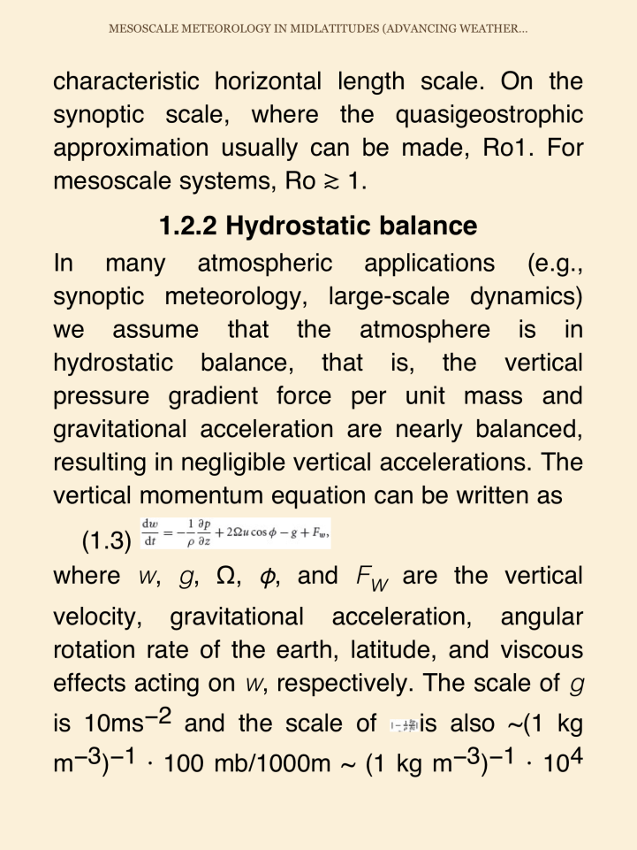
Reading maths content
Ebook content often presents maths as images
ePub 3 supports MathML
ePub3 readers:
iBooks on iPad, but no TTS
Ideal Reader on Android
Always ask publishers for ePub format over PDF!

Slide 22
Contact Details
Abi James
Visiting Research Fellow
Accessibility Group
ECS, University of Southampton
a.james@soton.ac.uk

